Slide 1

Neural Network Model
Std RegNo.: 2021-CS-164

Slide 2
CONTENTS
Introduction
System Overview
Key functions
Visual Representation
Result

Slide 3

Generalized Vector Model
Introduction
The Voice-Based Query Article Retrieval System allows users to input queries and retrieve relevant articles efficiently. The system processes the query, extracts keywords, expands them with synonyms, and ranks articles based on their relevance to the user's query.

Slide 4
System Overview
Generalized Vector Model
The system takes a user’s query as input, processes it to extract relevant keywords, and expands those keywords with synonyms for better search results. It then searches a collection of articles, ranks them based on relevance using cosine similarity, and displays the top matching articles to the user.

Slide 5
Key Features
Query Input: Takes user input (text query) to initiate the search process.
Text Preprocessing: Cleans the query by converting it to lowercase and removing unnecessary punctuation.
Keyword Extraction: Extracts key nouns or meaningful words from the query to form the basis for search.
Synonym Expansion: Expands extracted keywords by including related synonyms to improve search relevance.
Article Search & Retrieval: Searches through a collection of articles based on the processed query.
Ranking & Display: Ranks the retrieved articles by relevance using cosine similarity and displays the top results.

Slide 6
Key Features
Example:
Query Input: “Find me articles about machine learning.”
Keyword Extraction: Extracted keywords: “machine”, “learning”
Synonym Expansion: Expanded keywords: “machine”, “learning”, “AI”, “artificial intelligence”
Article Search & Retrieval: The system searches articles related to “machine learning”, “AI”, and “artificial intelligence”.
Ranking & Display: The system ranks the articles based on relevance and displays the top results to the user.

Slide 7
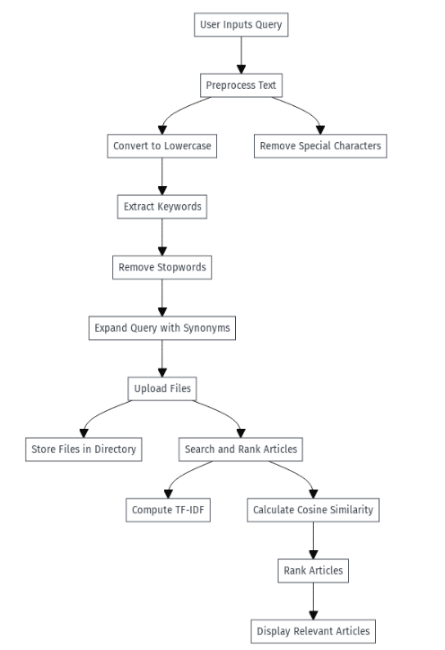
Visual Representation

Slide 8
Example
User Input and Preprocessing
Input: "Find me articles about climate change impacts."
Preprocessing Steps:
Convert to lowercase: "find me articles about climate change impacts."
Remove special characters: "find me articles about climate change impacts"
Keyword Extraction
Remove stopwords: ["find", "articles", "climate", "change", "impacts"]

Slide 9
Query Expansion
Synonyms added:
climate → weather, environment
change → alteration, shift
Expanded Query: ["climate", "change", "weather", "environment", "alteration", "shift", "impacts"]
File Upload and Searching
Uploaded Files:
climate_report.txt
environmental_impact.txt
weather_patterns.txt
Ranking Articles
TF-IDF Computation:
Keywords from query matched against uploaded articles.
Cosine Similarity Scores:
climate_report.txt: 0.85
environmental_impact.txt: 0.67
weather_patterns.txt: 0.43

Slide 10
Output
Top 3 Ranked Articles:
climate_report.txt
Preview: "This report discusses the impacts of climate change on global weather systems..."
environmental_impact.txt
Preview: "Environmental shifts are deeply influenced by changes in climate conditions..."
weather_patterns.txt
Preview: "Weather patterns are undergoing significant alteration due to climate dynamics..."

Slide 11
Generalized Vector Model
Result
Keyword Extraction & Query Expansion:
Extracted and expanded keywords to improve search results.
Article Search & Ranking:
Articles are ranked based on relevance using cosine similarity.
Output of Relevant Articles:
Displays top 3 most relevant articles with content previews.
System Efficiency & Accuracy:
Ensures accurate retrieval of relevant articles based on expanded query.
Cosine similarity ensures high-quality matches.

Slide 12
Thank You
Std RegNo.: 2021-CS-164

